Slide 1
Advanced Features and Performance Evolution of Fault Tree Quantifier FORTE
April 1999
Woo Sik Jung
Korea Power Engineering Company, Inc.

Slide 2
Contents
1. Introduction
2. Overview of FORTE
3. Calculational Procedure
4. Benchmark Tests
5. Conclusions

Slide 3
1. Introduction
Need of Fast Quantification Algorithm - Risk Informed Regulation
  Many NPPs use Risk Monitors
    Frequent quantification of large single fault tree
  Large Risk Model
    PSA model Risk model (integrated single fault tree)
    Risk model (3,000 ~ 20,000 gates and events)
  Lots of Quantification
    For the maintenance scheduling/reporting and
    Risk-change assessment by equipment failure/test/maintenance

Slide 4
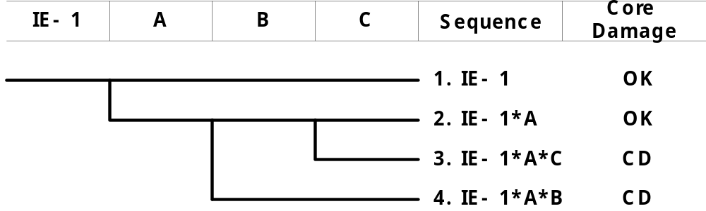
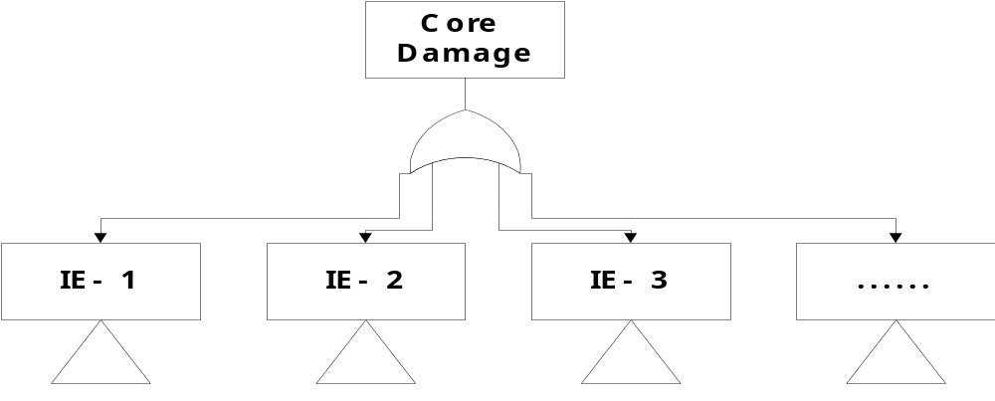
Large Risk Model
  PSA
  Risk Monitor

Slide 5
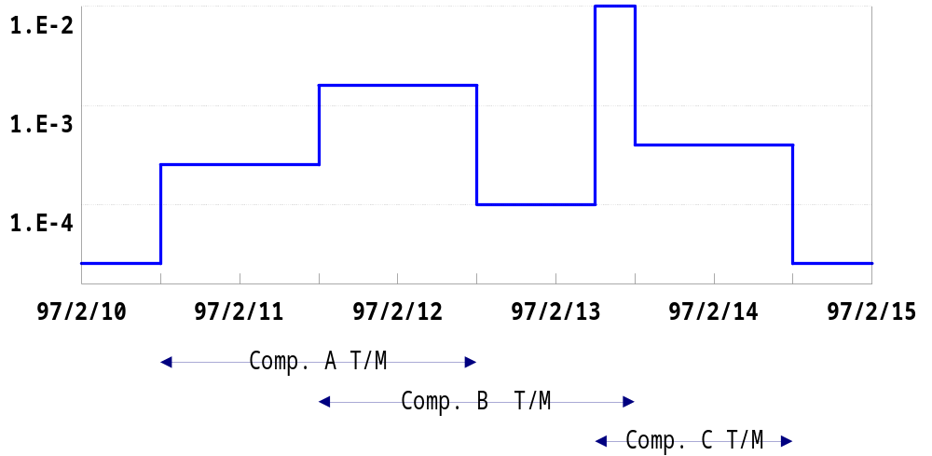
Lots of Quantification

Slide 6
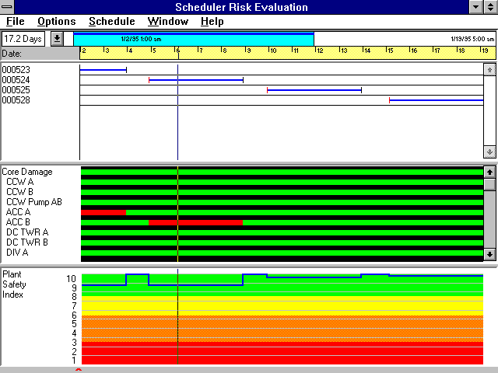
EOOS (EPRI R&R Workstation, USA)

Slide 7
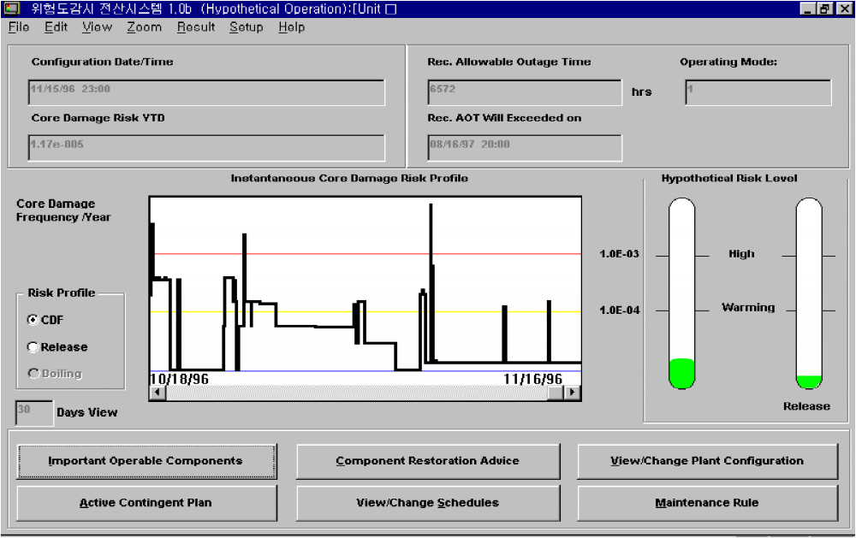
Safety Monitor (Scientech, USA)

Slide 8
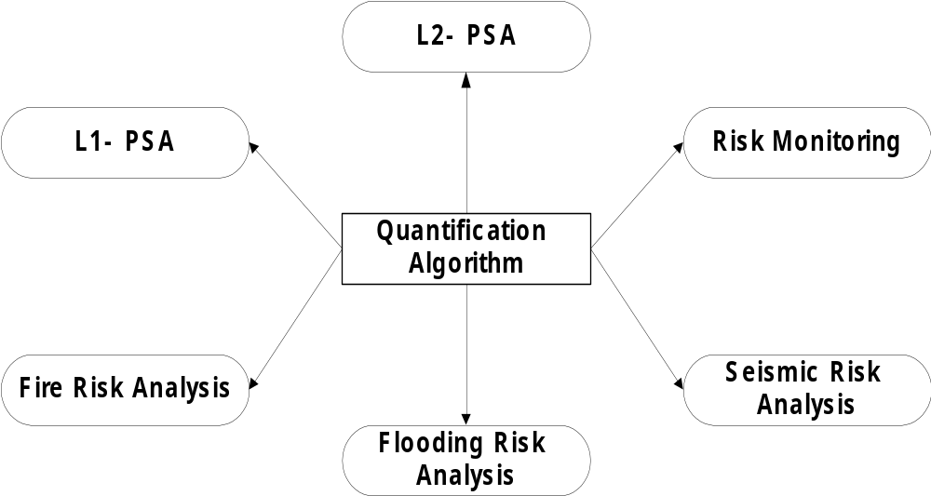
Fault Tree Quantifier - Key of PSA

Slide 9
Development Periods
  Personal development (‘94 ~ ‘96)
  Official development at KOPEC (‘97 ~)
SAIC is Committed to the Commercialization of FORTE
  Florida Power, Commonwealth Edison, Southern Nuclear, SAIC - 1998
  Expected 5 More NPP Utilities (USA, Mexico, Spain) and NASA - 1999

Slide 10
2. Overview of FORTE
Main Features
  ANSI C, 32-bit console application, bottom-up algorithm
  Many unique ideas were implemented to
    FT restructuring, gate expansions, Boolean absorption, and data storage
  FORTE can
    Handle all types of logical gates
    Solve multiple tops in a single run
    Give proper MCSs for fault tree with negates or approximate answers by Delete-term procedure
  FORTE can solve in a single run
    SEQ = IE * /A * /B * /C * D * E * F = IE * (A+B+C) * D * E * F

Slide 11
Main Specifications
  Maximum length of gate/basic event name < 32 Characters
  Maximum gate/basic event/ Initiator/house event < 2³¹
  Maximum MCS number = limited by available memory
  Input file : KIRAP, FTAP, SETS
  Output file :
    binary-mode RAW file for EPRI R&R Workstation,
    text-mode for general purposes
  Default functions
    Delete MCSs with multiple initiators
    Detect loop

Slide 12
3. Calculational Procedure
Restructure Fault Tree
  Performed to get all possible largest modular sub-trees (modules)
Identify Modules
Expand Gates Following Bottom-up Procedure
  Modularized MCSs of top event
Expand Modules in MCSs of Top Event
  MCSs of top event
  Probabilities of top event

Slide 13
Restructuring
  Convert special gate to equivalent one in terms of AND and OR logic
  Perform house event pruning
  Merge gates linked with same logic
    (A+B)+(A+C+D) = A+B+C+D
    (AB)(ACD ) = ABCD
  Move upward common events under the AND gates
    (A+B+C+D) (A+B+E+F) = A+B+(C+D) (E+F)
    (A+B)(A+B+C)(A+B+D) = A+B+NULL(C)(D) = A+B
  Factorize events within a gate or among similar gates
    (ABC+ABD+ABE) = AB(C+D+E)
    Latent modular sub-trees are obtained
  Prune away sets ( < truncation probability or subsets) during the restructuring

Slide 14
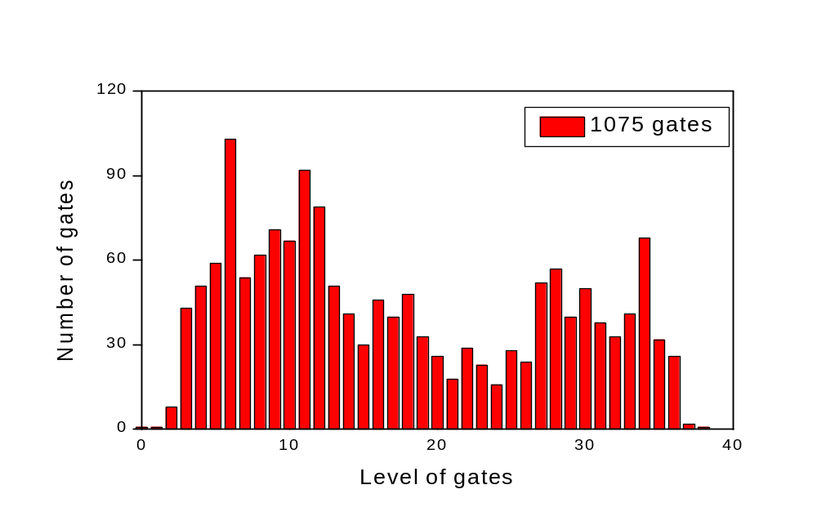
Identification of Modular Sub-trees
  Initial fault tree

Slide 15
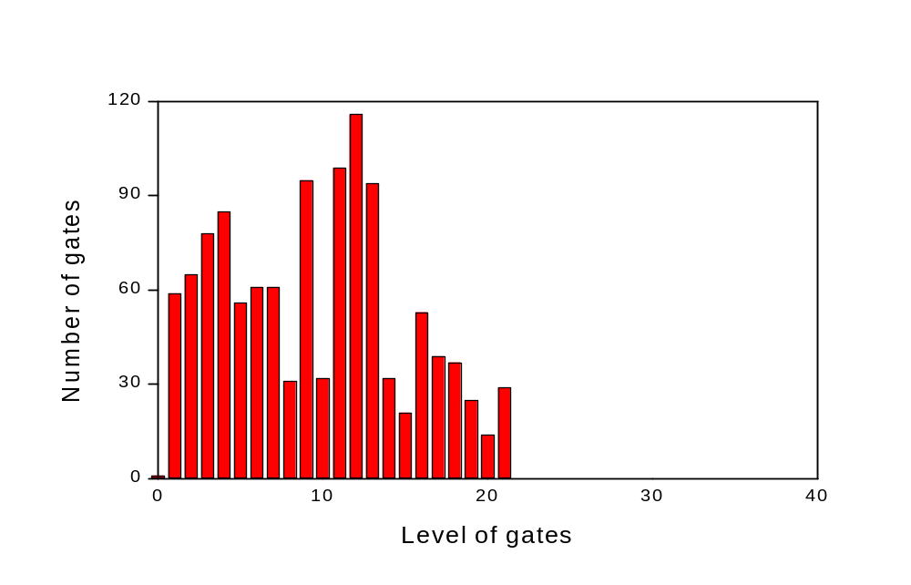
  Merged fault tree

Slide 16
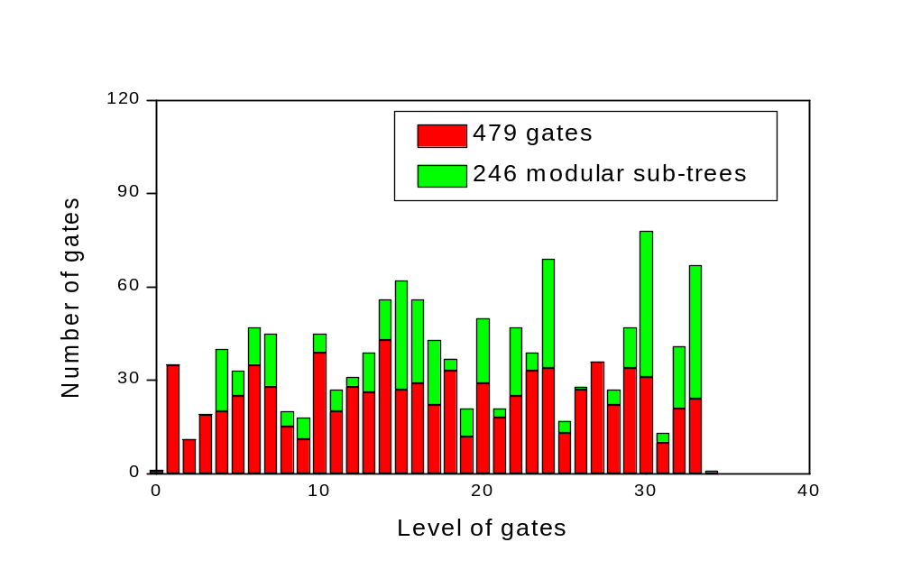
  Restructured fault tree

Slide 17
Expansion of Gates
  Modules
    Solve modules
    Assign the largest MCS probability to module
  Regular Gates
    Solve regular gates following optimal path (bottom-up procedure)
      levels and complexity measure are used to find optimal path
    Get modularized MCSs of top event
      MCSs expressed by basic events and modules

Slide 18
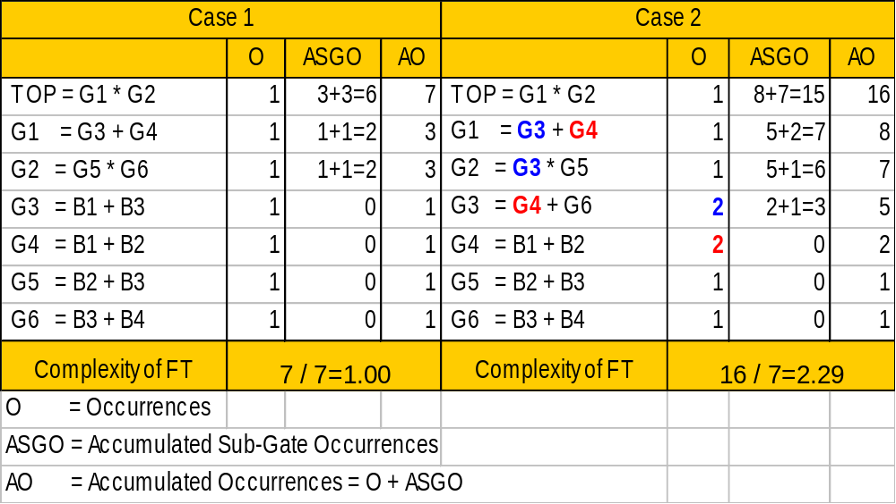
  Complexity Measure
    Approximate FORTE measure of difficulty to solve given gate
    High complexity means large number of transfer among gates
    Complexity of given gate = Accumulated Occurrences of given gate (AO)
    Complexity of fault tree = AO of top gate/number of gates

Slide 19
  Subset deletion
    Subset algorithm (G.C. Corynen, NUREG/CR-5242, UCRL-53828),
    Grouping method (N. Liminios, IEEE Trans. on Reliability. vol. 35, no.5, p.559,1986)
X X
X X X
X X X X
X X X X
X X X X
X X X
(A) X X
(A) X X X Group 1
(A) X X X X
X X X X
X X X X Group 2
X X X
(A) (C) X Group 11
(A) (C) X X
(A) X X X X Group 12
(B) X X X Group 21
(B) X X X
X X X Group 22
- Group 1 is SUBSET or mutually exclusive to Group 2
- Group 2 is SUPSET or mutually exclusive to Group 1
    FORTE subset algorithm had been developed independently,
    but it was found that it uses similar idea to them
    and it has the other advanced features

Slide 20
Expansion of Modules in MCSs of Top Event
  Get final MCSs of top event
    Expand modules in the modularized MCSs of top event
  Get first order probability
    Prob(Top) = P1 + P2 + …
    where Pi = Prob(A) * Prob (B) * … , probability of ith MCS
  Get minimal cut upper bound probability
    Prob(Top) = 1 - (1-P1)(1-P2) ….
    Completely implemented inclusion-exclusion principle

Slide 21
  Top event probability
1st order prob.
Minimal cutset upper bound
3rd order prob.
Exact prob.

Slide 22
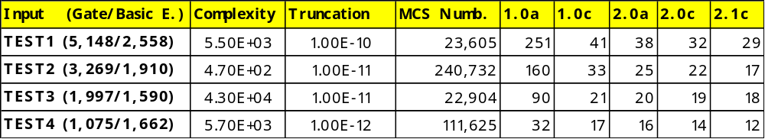
4. Benchmark Tests
Performed by
  KOPEC (Korea), SAIC (USA)
  Arkansas Nuclear One 1 & 2 (USA), Bohunice NPP (Slovakia)
  Ginna Station (USA), IBERDROLA (Spain)
FORTE Performance Evolution
        Pentium 166 MHz, 32MB RAM, Windows NT, running time (seconds)

Slide 23
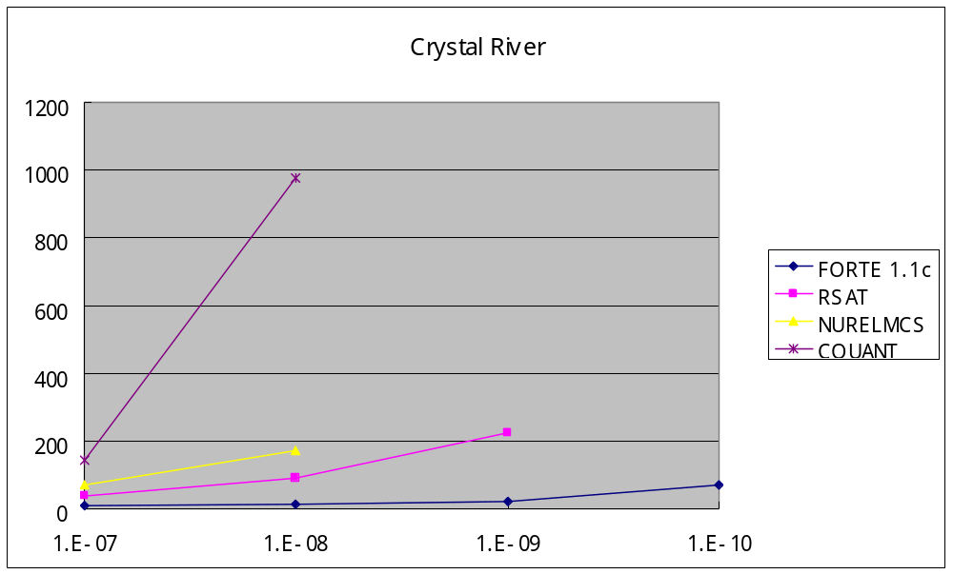
FORTE Benchmark Test : www-losaltos.saic.com/r&r/bench/bench.html
  EOOS Model (Crystal River, Florida Power Corp., USA)

Slide 24
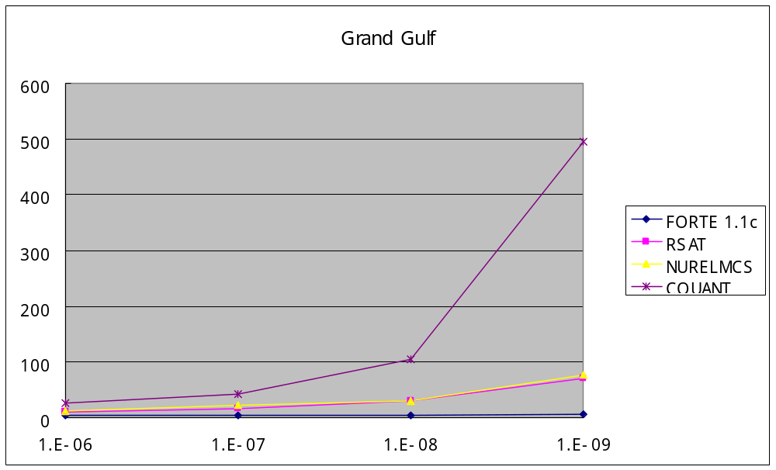
  EOOS Model (Grand Gulf, Entergy Corp., USA)

Slide 25
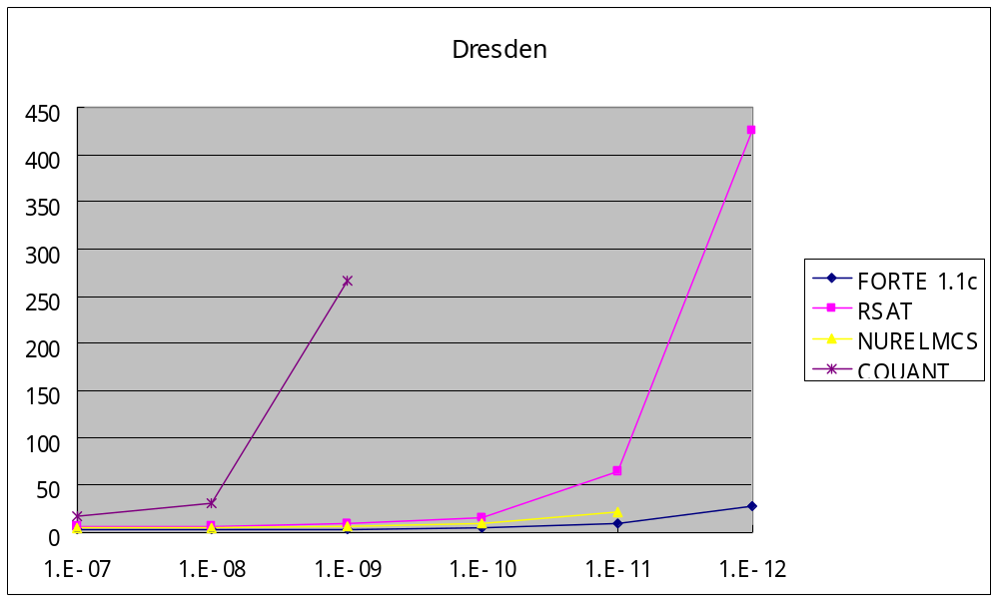
  EOOS Model (Dresden, Commonwealth Edison Co., USA)

Slide 26
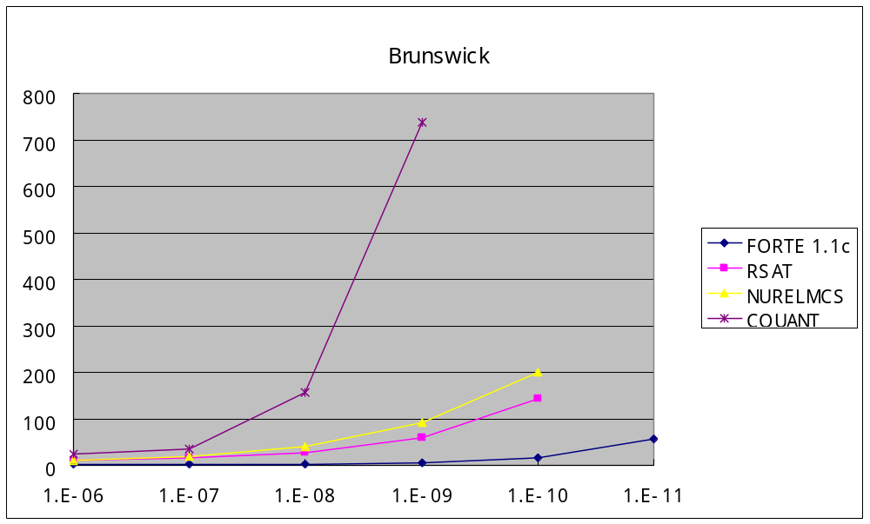
  EOOS Model (Brunswick, Carolina Power & Light Co., USA)

Slide 27
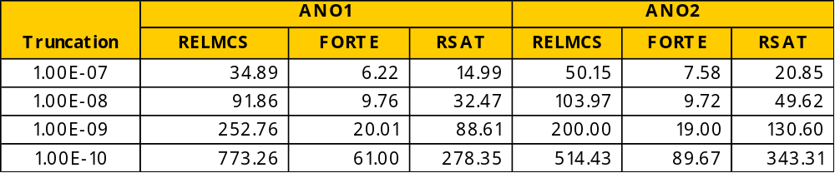
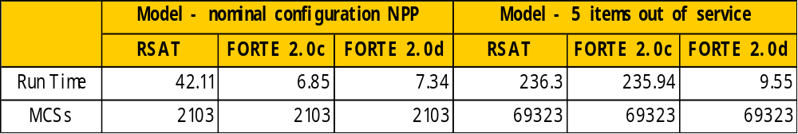
  EOOS Model (Arkansas Nuclear One 1 & 2, Entergy Corp, USA)
  EOOS Model (Bohunice NPP, Slovakia)

Slide 28
Extreme Cases
  EOOS Model (Ginna Station, Rochester Gas & Electric, USA)
    FORTE : 5 minutes
    Other Algorithms : several hours or days
  One Sequence (IBERDROLA, Spain)
    FORTE : 2 minutes
    RSAT : 2 hours
    NURELMCS : 2 days

Slide 29
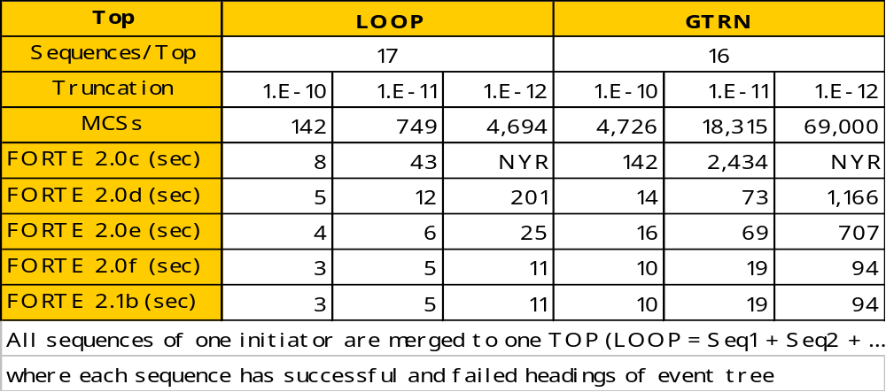
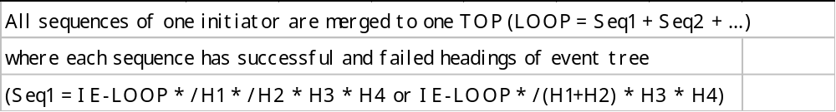
PSA Models (fault tree has negates, Korea Standard NPP)

Slide 30
  FORTE can solve directly
    SEQ = IE * /A * /B * /C * D * E * F = IE * (A+B+C) * D * E * F
  Other PSA softwares
    S_EVENT = A + B + C
    F_EVENT = IE * D * E * F
    Delete-term procedure to F_EVENT by S_EVENT

Slide 31
5. Conclusions
Factors Led to Successful Development of FORTE
  Creative unique ideas without preconception from existing algorithm (70 %)
  Simple and flexible programming structure to test creative idea (10%)
  Lots of Benchmark tests with SAIC to increase FORTE performance (20%)
FORTE will be a very useful tool to PSA and Risk Monitors
FORTE can be easily customized to satisfy future demands
Future Development
  Optimization and improvement of FORTE performance
  Development of PSA application tools to implement advanced features of FORTE

